Slide 1
Fast Blind Motion Deblurring
Lifu Wang

Slide 2
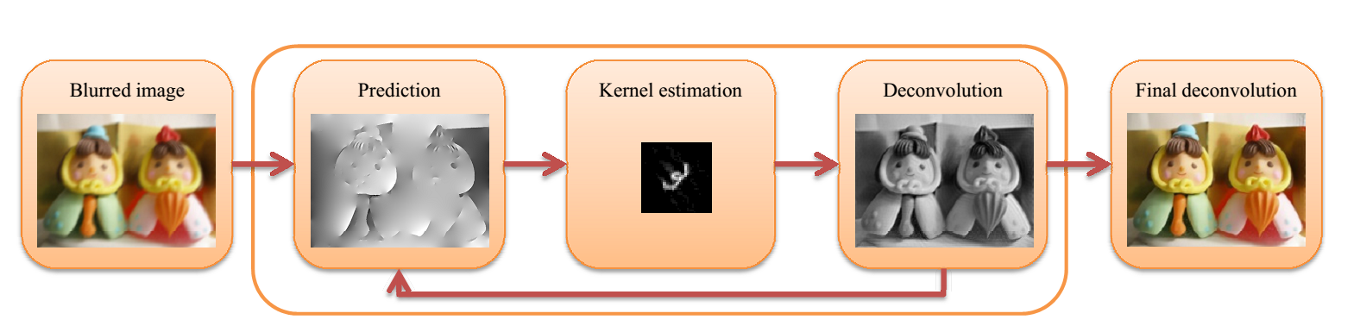
Fast Blind Motion Deblurring
Hights
Fast
Robust
Blind
Pipeline

Slide 3
Deblurring Results I
Images shown in this part are all captured from model phone or cameras.

Slide 4

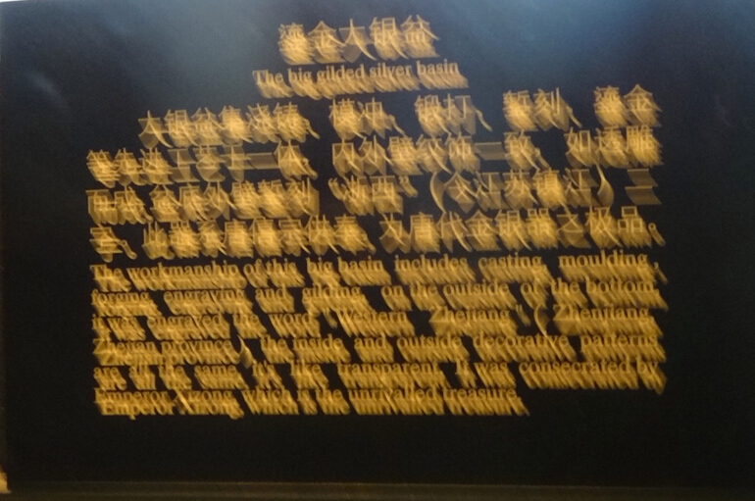
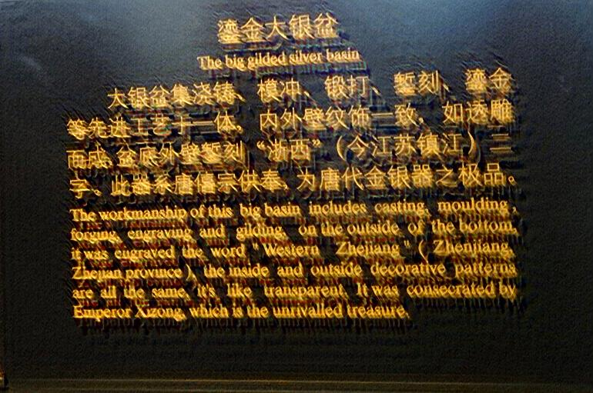
Results
Blurred Image
Deblurring Result

Slide 5


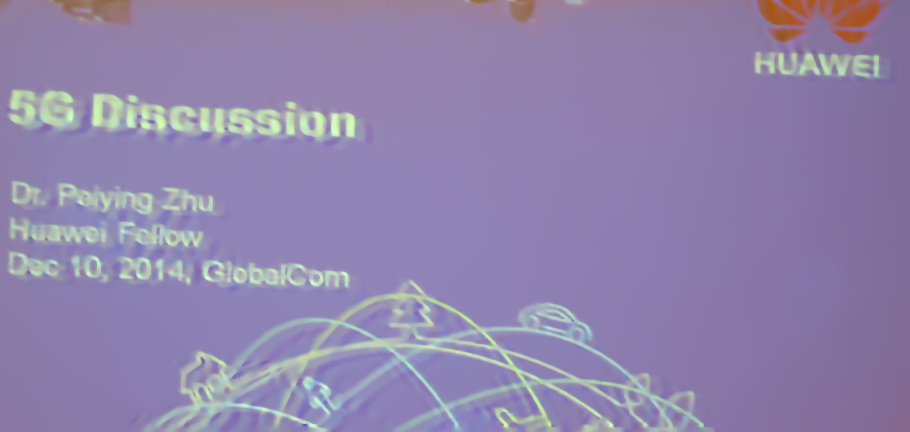
Results
Blurred Image
Deblurring Result

Slide 6



Results
Blurred Image
Deblurring Result

Slide 7

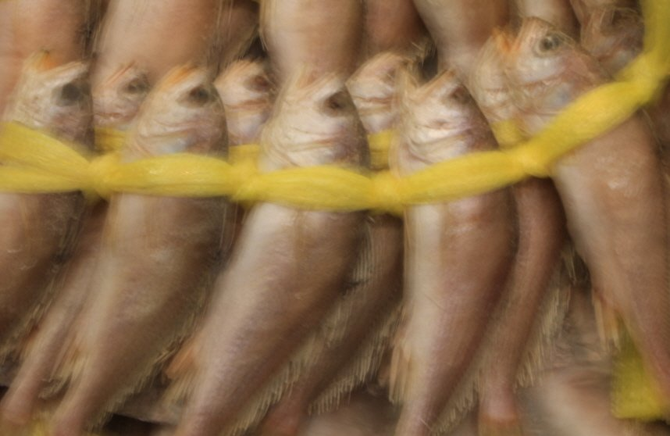
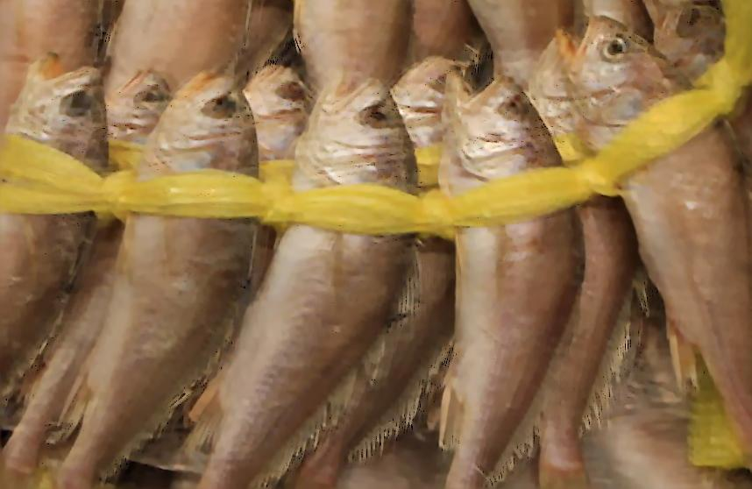
Results
Blurred Image
Deblurring Result

Slide 8
Results
Blurred Image
Deblurring Result

Slide 9
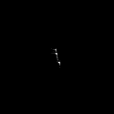

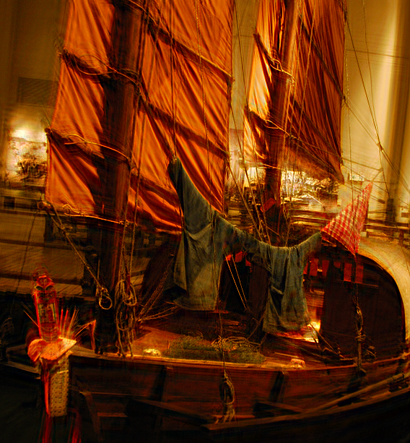
Results
Blurred Image
Deblurring Result

Slide 10
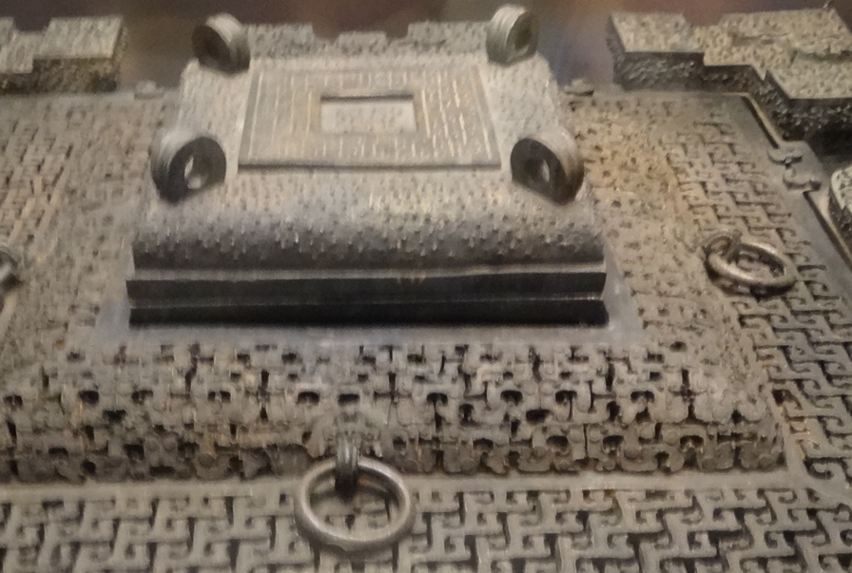

Results
Blurred Image
Deblurring Result

Slide 11
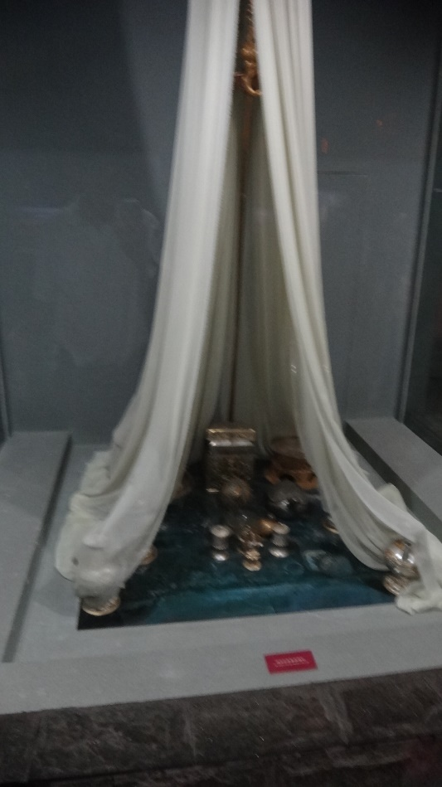

Results
Blurred Image
Deblurring Result

Slide 12

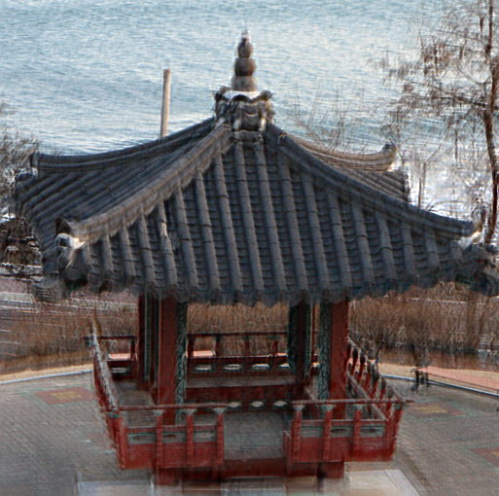
Results
Blurred Image
Deblurring Result

Slide 13
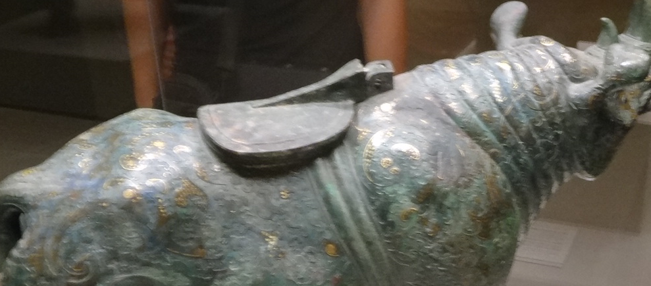

Results
Blurred Image
Deblurring Result

Slide 14
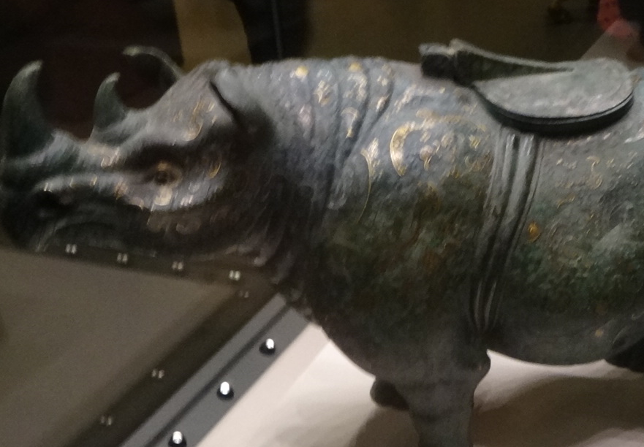
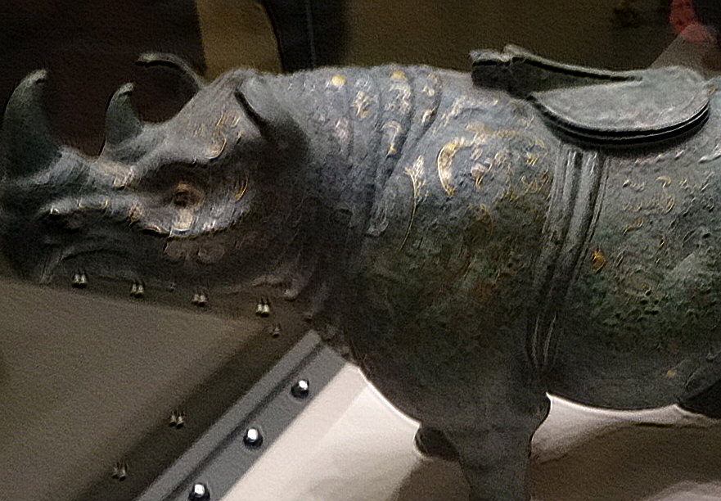
Results
Blurred Image
Deblurring Result

